Slide 1
BE ETHICAL GLOBAL MANAGER: RESPECT, HELP, DREAM, DARE! (Meta-Values) By John Thanopoulos November 29th 2019, Athens, Greece HSSS Conference, University of Piraeus

Slide 2
Remember we started our discussion on BE ETHICAL GLOBAL MANAGER by addressing the concepts:
SMILE, CREATE, CARE, HONOR, EXCEL, ACTUALIZE, ADAPT!

Slide 3
RESPECT

Slide 4
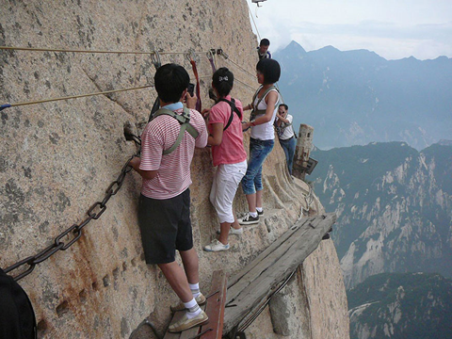
Reaching the top

Slide 5
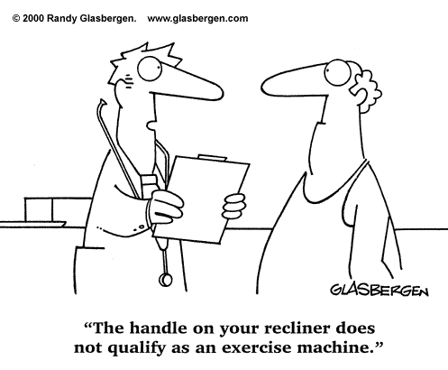
Exercise!

Slide 6
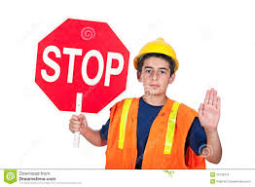
STOP sign: Give Priority

Slide 7
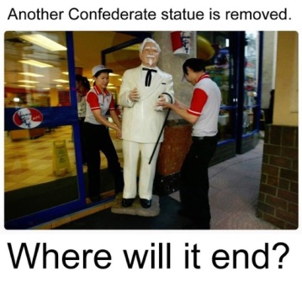
Man is a Political animal (Aristotle)

Slide 8
Economics!

Slide 9
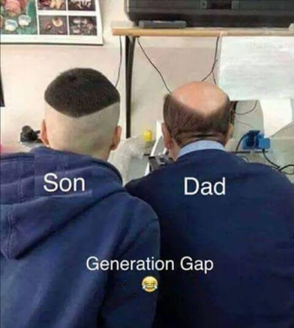
Capitalize on generation gaps

Slide 10
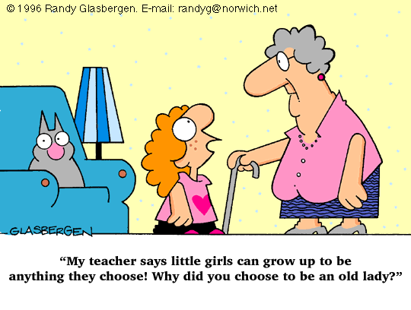
Teachings!

Slide 11
HELP

Slide 12
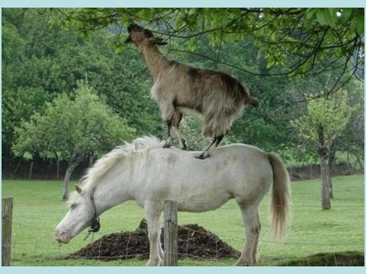
Help

Slide 13
Enjoy!

Slide 14
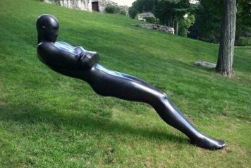
"Leaning" - a Statue by Emil Alzamora

Slide 15
Picture the World!

Slide 16
DREAM

Slide 17
Dream!

Slide 18
Respect the elders!

Slide 19
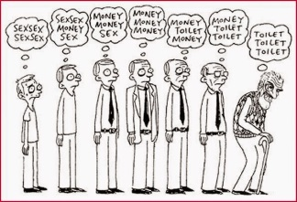
Evolution!

Slide 20
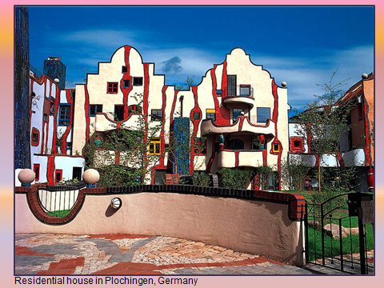
Architectural logic
Atomic bomb

Slide 21
Married!

Slide 22
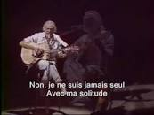
…. Solitude (George Mustaki)

Slide 23
DARE!

Slide 24
Dream the uncommon!

Slide 25
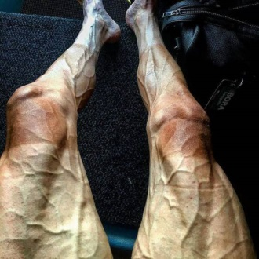
How a cyclist’s legs look After the “tour of France”

Slide 26
Reality ???

Slide 27
Expect the unexpected

Slide 28
….add here the “expect the unexpected” video (from my 11/19/19 email)

Slide 29
Three CONCEPTS that IMPRESSED YOU MOST

Slide 30
Ου γαρ τη μοι Ζευς ην ο κηρύξας τάδε …. (Αντιγόνη Σοφοκλέους)
Άμες δε γ’ εσόμεθα πολλώ κάρωνες !!!!
Θεοφιλοσοφικές θέσεις ….
Προσδοκώ ανάσταση νεκρών ;;;;
Ο ζων ελπίζων αποθνήσκει χάσκων ;;;;

Slide 31
Those were self-actualization and “meta”-values concerns of the global manager; What about meaning of life?

Slide 32
Meaning of Life:
Belonging
Independent Living
Evolution of Purpose
Storytelling
Be of Service
Trancedance: Think of relativity

Slide 33
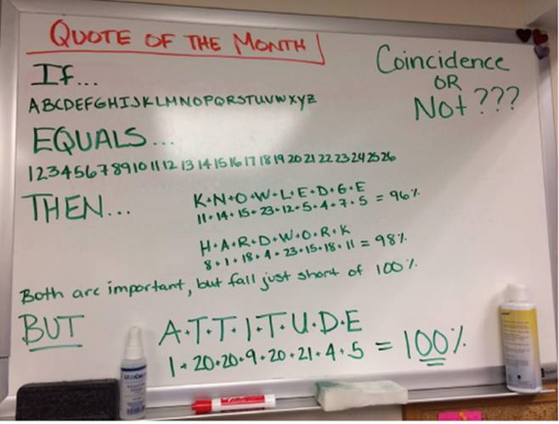
Oh! Again! The main concept behind all these is
ATTITUDE! YOUR ATTITUDE!!!

Slide 34
Thanks for listening, any questions?
John Thanopoulos, Ph.D. (thanioa@otenet.gr)
Best World Education Congress IB Professor (2012)
November 29th 2019

